Slide 1
CS 4350: Fundamentals of Software Engineering Lesson 5.3 Testing Systems
Jonathan Bell, Adeel Bhutta, Ferdinand Vesely, Mitch Wand
Khoury College of Computer Sciences
© 2022 Released under the CC BY-SA license

Slide 2
Outline of this lesson
How can we test complex systems?
What are some ways to substitute out parts of the system?

Slide 3
Learning Objectives for this Lesson
By the end of this lesson, you should be able to:
Describe the limitations of automated testing;
Be familiar with test “doubles” such as “stubs, mocks, spies, fakes”
Contrast “mocks” and “spies” in testing;
Give some useful examples of nondeterministic testing.
For Further Reading
Check out Martin Fowler’s article, “Mocks Aren’t Stubs” https://martinfowler.com/articles/mocksArentStubs.html
“xUnit Test Patterns: Refactoring Test Code” by Gerard Meszaros

Slide 4
Large Systems are Hard to Test
Database component
Contents may need to reflect/simulate real-world;
Data may be expensive/proprietary/confidential.
Network connections
”Real” connections may be slow/flaky/disrupted;
Resources may have changed since test was written.
Environment
Interactions with OS, locale or other software.
Human actors
Ultimately unpredictable.
4

Slide 5
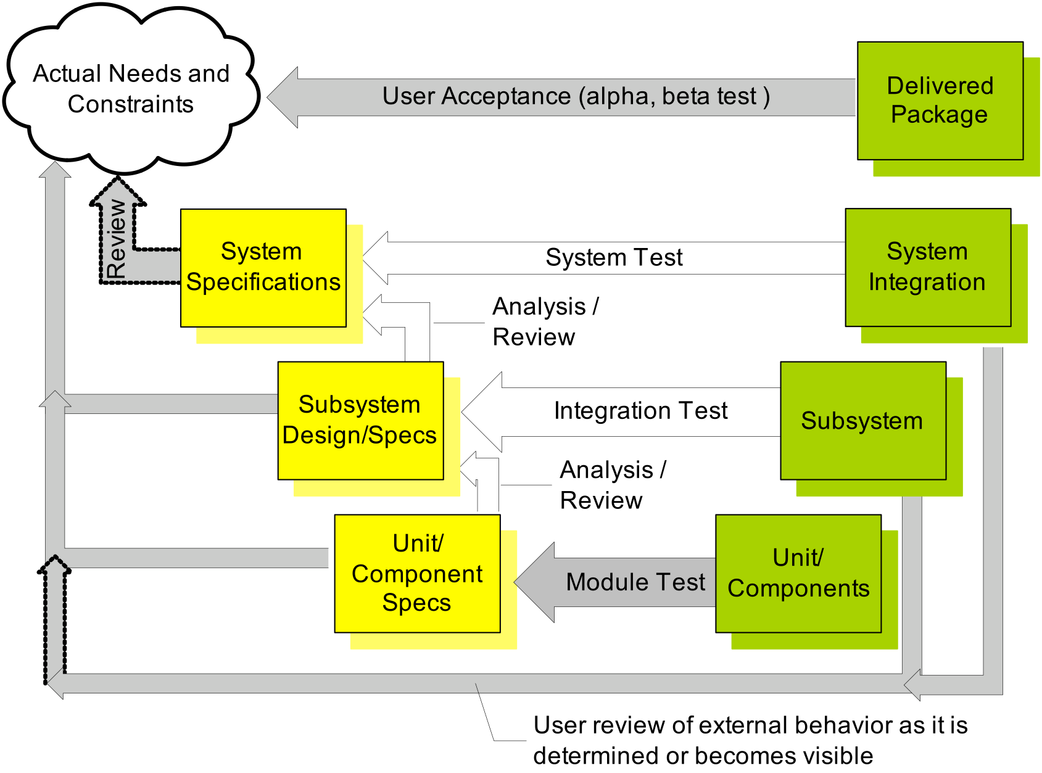
Unit Testing is not sufficient
Typical use Drivers and Stubs
Overall systems are “a little more” complicated
Driver
Stub
Stub
5
Notes:
Stubs provide canned answers to calls made during the test, usually not responding at all to anything outside what's programmed in for the test.

Slide 6
Two Ways to Handle Difficulties
Pay the cost, do the test
Automate with tools:
A large test can reveal problems that smaller tests can’t.
Choose particular times (rare!) to do particular large tests.
An “enormous” test at Google simulated an earthquake in Mountain View, CA.
See Chapter 14 of SE@Google
Use “Test Doubles”
Stubs
Mocks / Spies
Fakes
Random testing
“Fuzzing”
Against a reference implementation.
Rest of
Lesson
Notes:
https://jesusvalerareales.medium.com/testing-with-test-doubles-7c3abb9eb3f2

Slide 7
Test Double Example
Mo
Business Logic
Network
Resources
Random user
Database
Mock network
Fake Database
Notes:
If you are working on a system which sends an email to customer after an operation, how will you test it? Instead of sending a real email every time you test, you can use doubles (i.e., a mock mail service)

Slide 8
Test Stub
Supply an object with the same interface:
Same methods;
Default result values (i.e., canned answers).
The stub gets the test to run:
If the client blindly uses the stub, it can proceed;
If the client expects something specific from the object, the test will likely fail.
Need two more things:
Remember how the stub was used;
Tell the stub what to do when it is called.

Slide 9
Test Stub Example
final class Service {
public function doSomething(UserModelInterface user): Int {
/* Do things */
return user.uuid;
}
}
final class ServiceTest extends TestCase {
public function testDoSomething(): void {
// The service needs a implementation `UserModelInterface`.
String uuid = (new Service()).doSomething(new UserStub());
self.assertStringContainsString('0000-000-000-00001', uuid);
}
}
interface UserModelInterface {
public function getUuid(): String;
}
final class UserStub implements UserModelInterface {
public function getUuid(): String {
return '0000-000-000-00001';
}
}
getUuid() is a stub
Notes:
A stub is an object which returns fake data. Let’s imagine our service depends on a user-model, then the service does something, and finally, it returns the user’s UUID. We can create a stub object with fake values to assert the service works as expected.

Slide 10
Test Spies
A test spy is a stub that remembers how the object was called
Then the test harness can check what happened;
For example: a particular method should be called
First with parameters “foo” and 42;
Then with parameters “quux” and -88.
A spy can be useful on the “real” object:
What was sent on the network?
How many times a problem was logged?
What was inserted in the database?
But most often used with a “mock.”
Spy “remembers”
Notes:
Spies are stubs that also record some information based on how they were called. One form of this might be an email service that records how many messages it was sent.

Slide 11
Test Spy Example
final class UserNotifierTest extends TestCase {
public function testLogMessage(): void {
LoggerSpy logger = new LoggerSpy();
UserNotifier notifier = new UserNotifier(logger);
User user = new User(name = 'Jesus');
notifier.registerUser(user);
self.assertStringContainsString(
"Notifying the user: {user.name()}",
first(logger.messages) ); }}
interface Logger {
public function log(String message): void;
}
final class LoggerSpy implements Logger {
public Array messages = [];
public function log(string message): void {
this.messages[] = message;
}
}
final class UserNotifier {
public function __construct(private Logger logger) {}
public function registerUser(UserModelInterface user): void {
this.logger.log("Notifying the user: {user.name()}");
// ...
}
}
Logger “remembers” messages
Notes:
A test spy is an object capable of capturing indirect output and providing indirect input as needed. The indirect output is something we cannot directly observe. In the snippet, we can know exactly how many times the log() method has been called, as well as the content of the messages. The point of this spy is to have much more knowledge of the internal object state in exchange for deeper coupling, which could be problematic in the future because it makes our tests more fragile.

Slide 12
Test Mocks
A test mock has scripted results:
If such-and-such a method is called
return some particular value.
A complex mock can have many scripts:
Multiple methods;
Different results for subsequent calls.
Useful mocking assumes we know how mocked object will be used.
If a “mock” has real logic, it becomes a “fake”.
Mock has “scripted answers” and is used for “behavior verification”
Notes:
Mocks are what we are talking about here: objects pre-programmed with expectations which form a specification of the calls they are expected to receive. Mocks use behavior verification, where we instead check to see if the object made the correct function calls as expected.

Slide 13
CoveyTownController uses Mocks
describe('townSubscriptionHandler', () => {
const mockSocket = mock<Socket>();
let testingTown: CoveyTownController;
let player: Player;
let session: PlayerSession;
beforeEach(async () => {
const townName = `connectPlayerSocket tests ${nanoid()}`;
testingTown = CoveyTownsStore.getInstance().createTown(townName, false);
mockReset(mockSocket);
player = new Player('test player');
session = await testingTown.addPlayer(player);
});
it('should reject connections with invalid town IDs by calling disconnect', async () => {
TestUtils.setSessionTokenAndTownID(nanoid(), session.sessionToken, mockSocket);
townSubscriptionHandler(mockSocket);
expect(mockSocket.disconnect).toBeCalledWith(true);
});
......
Our test checks if MockSocket was called to disconnect
Notes:
Mocks are what we are talking about here: objects pre-programmed with expectations which form a specification of the calls they are expected to receive. Mocks use behavior verification, where we instead check to see if the object made the correct function calls as expected.

Slide 14
Test Fakes
A fake has an implementation of the object being replaced
A low-fidelity fake implements things partially
Enough to work for the test.
A high-fidelity fake implements most aspects:
Usually all functional aspects;
Usually not as efficiently or as scalable.
The purpose of the fake is to avoid processes/network/cost:
So the test can be cheap and deterministic.
Fake has
“semi-real implementation”
Notes:
Fake objects actually have working implementations, but usually take some shortcut which makes them not suitable for production (an in memory database is a good example).

Slide 15
Test Fake Example
interface UserRepository {
public function getUserById(String uuid): User;
}
final class UserRepositoryFake implements UserRepository {
public function getUserById(String uuid): UserModel {
return new User(uuid, 'Jesus', "['ADMIN_ROLE']");
}
}
Fake is
a semi-real version of UserRepository
A fake can behave like a dummy, stub, spy or mock.
Notes:
A fake is a simpler implementation of real objects.
Fakes are used when we want to test an infrastructural class, in other words, fakes are for the classes which are beyond our application limit (repositories or queues, for example).
A fake can behave like a dummy, stub, spy or mock.

Slide 16
Random Input
To replace a user, we can program a “bot”
Randomly use mouse, press buttons;
Arbitrary text;
Fast or slow.
Smarter (“Fuzzing”)
Capture real actions;
Then make targeted mutations.
(This applies also to programs taking text input.)
Expected result can only be imprecise:
E.g., “not crash” or “not leak secrets”.

Slide 17
Related: Random Testing
SUT
Random
Input
Generator
=?
Errors
Ref.
Impl.

Slide 18
Weaknesses of Test Doubles
The Mock/Fake may not behave correctly
The test harness may assume wrong behavior;
Particularly an issue if original object changes
Mocks have to be maintained as well!
Solution: Test the mock/fake against a higher fidelity fake, or against the real thing.
The SUT may use a different algorithm:
The Spies expect a particular usage of double;
The test is “brittle” because it depends on internal behavior of SUT;

Slide 19
Review: Learning Objectives for this Lesson
You should now be able to:
Describe limitations of automated testing;
Be familiar with test “doubles” such as “stubs, mocks, spies, fakes”
Contrast “mocks” and “spies” in testing;
Give some useful examples of nondeterministic testing.

